Slide 1
Smart Multi-Protection System
Presenter 1 — Tahomid Uddin (20220105152)
Introduction and Background
The problem: in a conventional distribution setup, a fault in one load can force a common breaker to disconnect everything.
Our objective: a low-cost, Arduino-based system that monitors four load branches, each with its own ACS712-5A current sensor and its own relay channel.
What it does: it detects overload and line-to-ground (short-circuit) faults, trips only the faulty branch, sends an SMS alert through a GSM module and shows branch status on a 16×2 LCD.
The result: healthy branches keep running. This is load-wise fault isolation.
Load-wise Fault Isolation
Individual trip in every branch
SUBMITTED BY
1. Tahomid Uddin (20220105152)
2. Shams Mohammed Suha Chowdhury (20220105172)
3. Farhan Rakeen (20220105173)
4. Ahmed Eyenun Nishat (20220105237)
5. Tausif Naim Jami (20220105245)
SYSTEM AT A GLANCE
AC 220 V supply
ACS712-5A × 4
Arduino UNO
Relay + LCD + SMS
SUBMITTED TO
Mr. Md. Abdullah-Al-Mamun
Mr. Md. Sadman Amir
Four parallel branches
One current sensor per branch
Threshold comparison and trip command
Branch trip, status, GSM alert
4th Year · 2nd Semester · Section CD

Slide 2



Theory: Over-current Protection and Selectivity
Presenter 1 — Tahomid Uddin (20220105152)
Core protection theory
Key equations
Over-current protection operates when current rises above a selected pickup value, and it must clear the abnormal condition before conductors or equipment are damaged.
Selectivity means the device closest to the fault trips first. Here, the relay of the affected branch is the primary isolating element.
A relay isolates a load by opening its contact. The Arduino never carries load current; it only sends a low-voltage control signal to the relay module.
Healthy branches stay energized because only one relay opens. This is the key difference from a single common trip for the whole model.
A line-to-ground fault draws a very high current and needs near-instant tripping, whereas an overload is cleared once its threshold is crossed.
I_{rms} = √[ (1/N) Σ i_{k}² ]
i = instantaneous current sample; N = samples in one window
I = (V_{ADC} − V₀) / K
V₀ = zero-current offset; K = calibrated sensitivity (found by testing)
Theory applied to this project
Each ACS712-5A turns its branch current into an analog voltage for the Arduino ADC.
The Arduino compares each branch current with a pre-set trip threshold.
Only the affected branch relay opens; the other relays stay closed.
An SMS alert and an LCD message report the trip while healthy branches keep running.

Slide 3
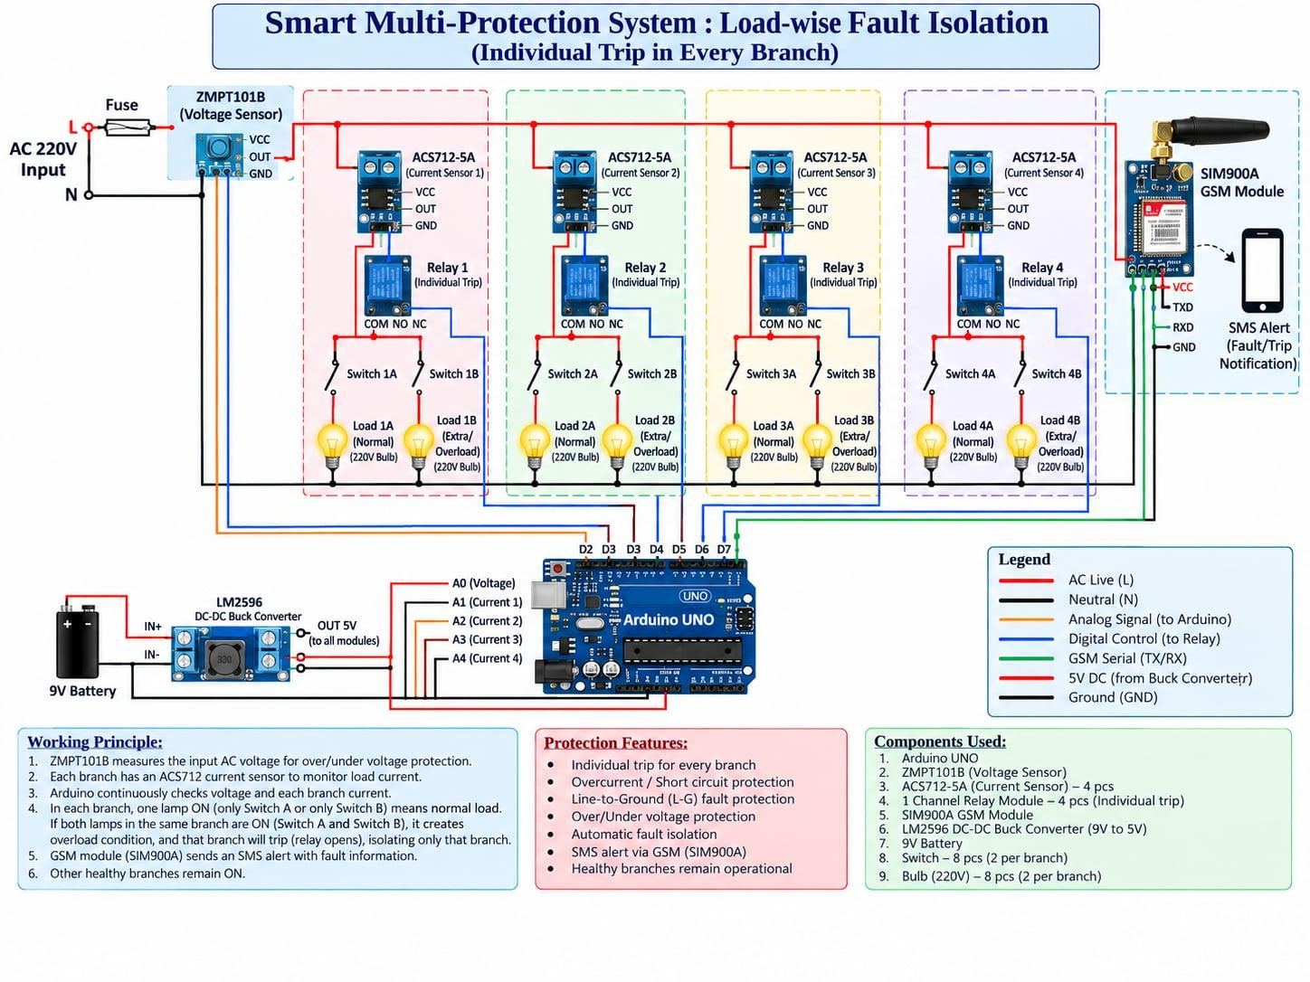

Circuit Diagram and Hardware Architecture
Presenter 2 — Shams Mohammed Suha Chowdhury (20220105172)
Architecture explanation (as built)
AC 220 V is distributed to four parallel branches.
Each branch has one ACS712-5A sensor (A0–A3) and its own channel on the 4-channel relay module, driven by a separate Arduino pin.
Two inline switches per branch control Load A (Normal) and Load B (Extra/Overload), both 220 V bulbs.
A GSM module sends SMS alerts, a 16×2 I2C LCD shows status, and a push button resets a tripped branch.
A DC adapter powers the Arduino; two buck converters condition the GSM and relay-coil supplies.
As built vs diagram: the ZMPT101B voltage sensor, fuse and battery were omitted, and one 4-channel relay module replaces four single relays.
Reference diagram (original design intent). The as-built prototype differs as noted on the right.

Slide 4


Working Procedure: Normal, Overload and Trip
Presenter 2 — Shams Mohammed Suha Chowdhury (20220105172)
Wire + code
Normal run
Overload test
Trip + alert
Reset
1
2
3
4
5
Assemble, then upload sketch
Switch A only, no trip
Close Switch B
Relay opens, SMS sent
Push button, restore
Detailed working procedure
Safety and demonstration points
Wire each branch with its ACS712-5A sensor, relay channel, two switches and two bulbs; connect A0–A3, relay inputs, GSM, LCD and push button.
Power the Arduino from the DC adapter and upload the sketch before switching on the AC supply.
Close only Switch A in each branch; the bulbs glow and readings stay normal.
Close Switch B in one branch: its current crosses the threshold, only that relay opens, and the other three keep running.
Check the SMS alert and LCD fault message. For the short-circuit test, briefly connect a branch sensor load path to neutral; the relay trips almost instantly.
Clear the fault, press the push button to reset, and re-close the switches.
Check all low-voltage connections before applying 220 V AC.
The Arduino sends only low-voltage control signals; the relay contacts carry the lamp current.
Do the short-circuit test briefly and carefully, with strict insulation on the 220 V wiring.
Key line to explain: branch current high → Arduino detects → relay opens → SMS and LCD → healthy branches stay ON.

Slide 5

Technical Analysis: Sensing and Trip Decision
Presenter 3 — Farhan Rakeen (20220105173)
Sensing and decision logic
Formula panel
The ACS712-5A is a Hall-effect sensor: branch current creates a magnetic field and the sensor outputs a proportional analog voltage.
The Arduino reads A0–A3, one branch per pin, and converts each reading to load current, sampling continuously.
Each branch current is compared with a pre-set threshold; a crossing drives the matching relay channel, an LCD message and an SMS.
Thresholds come from calibration, because small offset or gain errors shift the trip point.
V_{ADC} = (ADC_count / 1023) × V_{ref}
I = (V_{ADC} − V₀) / K
Arduino UNO 10-bit ADC (0–1023); V₀ = offset, K = calibrated sensitivity
Trip rule: if I_branch ≥ I_trip, open that relay and send an SMS.
DECISION TABLE USED FOR EXPLANATION
Measured condition | Controller interpretation | Expected action
Normal load (Switch A only) | Current below threshold | Relay stays ON; LCD shows the live reading
Overload (Switch A + B) | Branch current crosses threshold | Only that relay opens; SMS and LCD fault message
Line-to-ground / short circuit | Very high fault current sensed by ACS712 | Relay trips almost instantly
Abnormal supply voltage | Not sensed (no voltage sensor fitted) | No protective action; outside current scope

Slide 6


Engineering Analysis: Selectivity and Reliability
Presenter 3 — Farhan Rakeen (20220105173)
Selectivity and coordination
Selective tripping illustration
Selectivity means the protective element nearest the fault clears it while unrelated sections stay energized.
Each ACS712 is a local detector, and its own relay channel is the first isolating device for that branch.
Four relays share one board, but each has its own Arduino pin, so tripping one leaves the others unaffected.
Backup is still needed: this prototype has no fuse, so a real system keeps a main breaker or fuse upstream.
AC 220 V supply
Branch 1
ON
Branch 2
TRIPPED
Branch 3
ON
Branch 4
ON
Only the faulty branch relay opens; the other three stay energized.
Performance factor | Why it matters in this model
Calibration | ACS712 offset and gain errors shift trip thresholds, causing nuisance trips or missed faults.
Relay speed | Electromechanical relays and Arduino polling are slower than breakers or solid-state switching.
Sensor drift and noise | ACS712 readings drift with temperature and pick up noise on a prototype board.
Shared relay board | One PCB carries all four relays, so a board fault could affect more than one branch.
GSM coverage | SMS needs network and SIM availability; the trip still happens and the LCD still shows the fault.

Slide 7
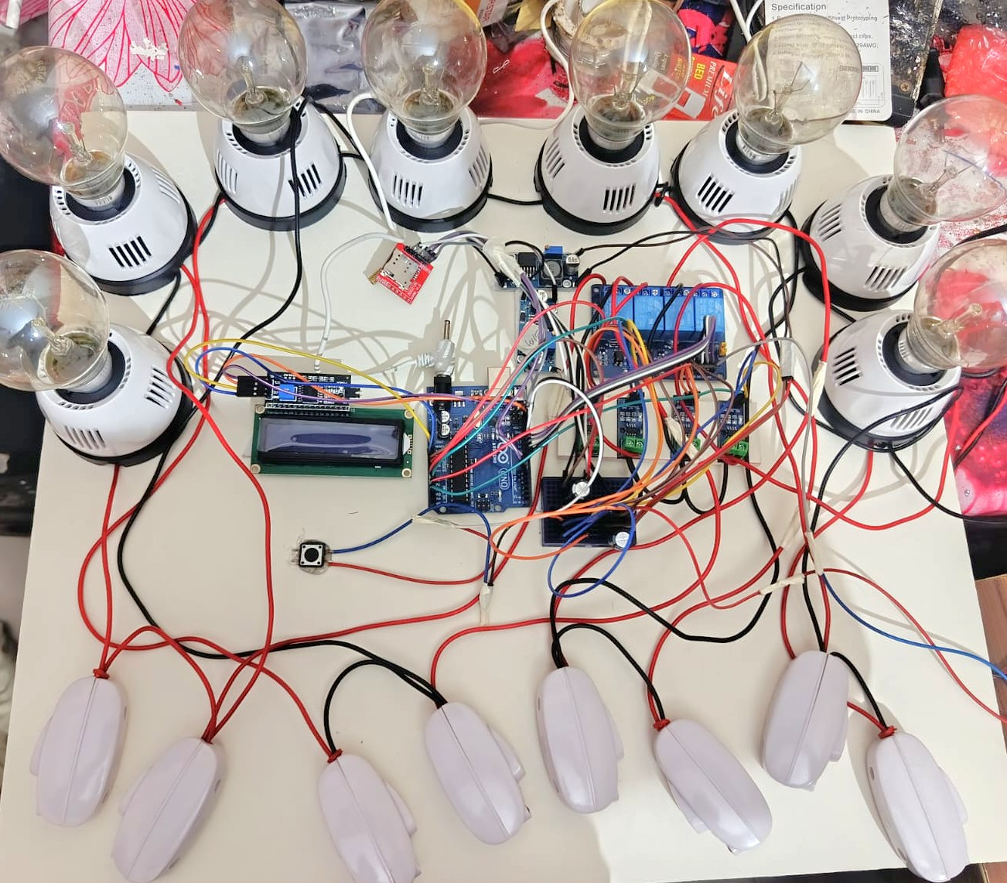
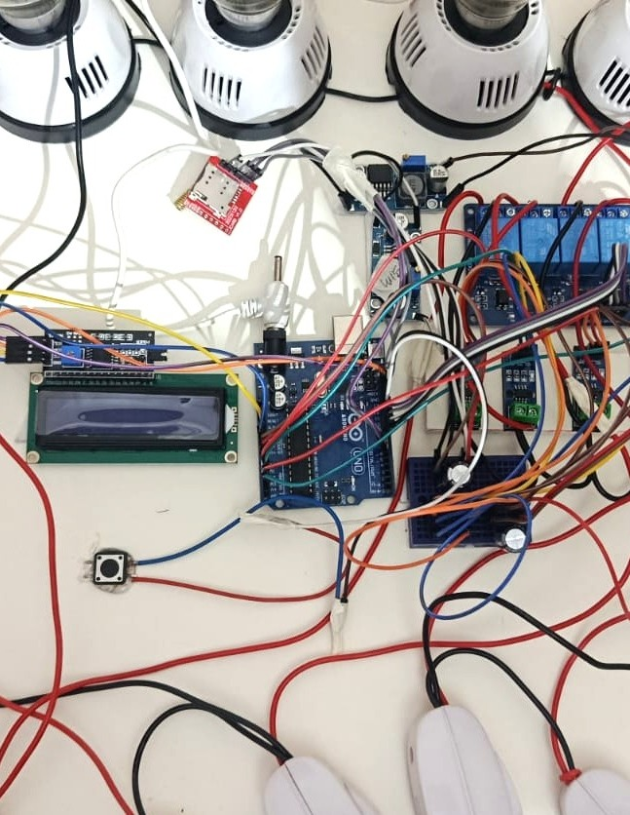

Real Project Implementation: Hardware Layout
Presenter 4 — Ahmed Eyenun Nishat (20220105237)
What the photos show
A real, working prototype wired on a rigid mounting board; no custom PCB is used.
Centre: Arduino UNO with the 16×2 I2C LCD and the reset push button.
Right of centre: GSM module, two buck converters, the 4-channel relay module and the ACS712-5A sensors.
Eight inline switches and eight 220 V lamp holders form four branches, each with a Normal and an Extra/Overload bulb.
Dense wiring shows why labelling, insulation and separating 220 V AC from control wiring are essential.
Full view: lamps around the board, switches at the bottom
Close-up: LCD, Arduino UNO, relay module
4
branches
4
ACS712-5A sensors
4
relay channels
8
lamps and switches

Slide 8



Applications, Advantages and Limitations
Presenter 4 — Ahmed Eyenun Nishat (20220105237)
Practical applications
Advantages
Limitations and fixes
Smart distribution boards for homes and small commercial sites.
Educational trainer for over-current protection and selective tripping.
Load-wise or room-wise safety demonstrations.
Base for future IoT notification and energy-monitoring projects.
Independent branches: each relay channel has its own Arduino pin.
Selective tripping keeps healthy branches powered.
SMS alerts for remote awareness and LCD status locally.
Simple push-button reset after the fault is cleared.
Low-cost, modular, off-the-shelf parts with real-time current monitoring.
No voltage sensing → add a ZMPT101B and main relay.
Slower mechanical relays → use solid-state relays.
No backup fuse → add an inline fuse or small MCB.
Shared relay board → four separate 1-channel modules.
SMS depends on coverage → add Wi-Fi/IoT alerts.
Manual reset only → add auto-reset with a lockout counter.
It is not a replacement for certified industrial relays, MCBs or RCCBs; it is a low-cost, scalable protection prototype.

Slide 9


Comparison and Result Discussion
Presenter 5 — Tausif Naim Jami (20220105245)
Feature | Fuse / MCB only | Arduino load-wise prototype | Industrial protection relay
Fault isolation | Disconnects the protected circuit; limited indication | Trips only the faulty branch; healthy branches stay ON | Selective tripping with certified protection elements
Monitoring | No continuous digital measurement | Arduino reads branch current through four ACS712-5A sensors | Accurate metering, event logs and communication
Notification | Manual observation needed | SMS through a GSM module, plus on-board LCD | SCADA or protocol alarm integration possible
Cost and complexity | Low cost, simple | Low cost, moderate complexity; ideal for education | Higher cost; reliable and standards-based
Observed demonstration behaviour
Result statement
With only Switch A closed, all four branches ran together and each current reading tracked its load.
Closing Switch B in one branch made its sensor register the rise, and only that relay opened.
Each trip produced an SMS naming the branch and a fault message on the LCD.
A proof-of-concept protection trainer. The result is the sequence: sensing → decision → selective trip → LCD and SMS → healthy branches continue. No numerical trip current or timing is claimed.

Slide 10


Conclusion and Key Takeaways
Presenter 5 — Tausif Naim Jami (20220105245)
Final engineering conclusion
Key takeaways
Low-cost, Arduino-based protection can isolate only the faulty branch while healthy branches keep running.
Four ACS712-5A sensors, a 4-channel relay module, GSM SMS alerts and an LCD work together in one prototype.
Testing confirmed load-wise isolation with local (LCD) and remote (SMS) notification, a stepping stone toward smarter distribution boards.
As built, there is no voltage sensing, so protection covers current-based faults only.
Selective isolation keeps healthy loads ON.
Per-branch current sensing detects overload and short-circuit faults.
The Arduino makes the decision but does not replace certified protection devices.
Calibration and safe wiring are essential.
Best presented as an educational protection prototype.
Future improvements
Thank you
Voltage sensing and main relay (ZMPT101B)
Solid-state relays for faster tripping
Auto-reset with retry and lockout counter
Wi-Fi/IoT backup notification
Questions are welcome.
Prepared for EEE 4252 Power System Protection Lab

